Slide 1
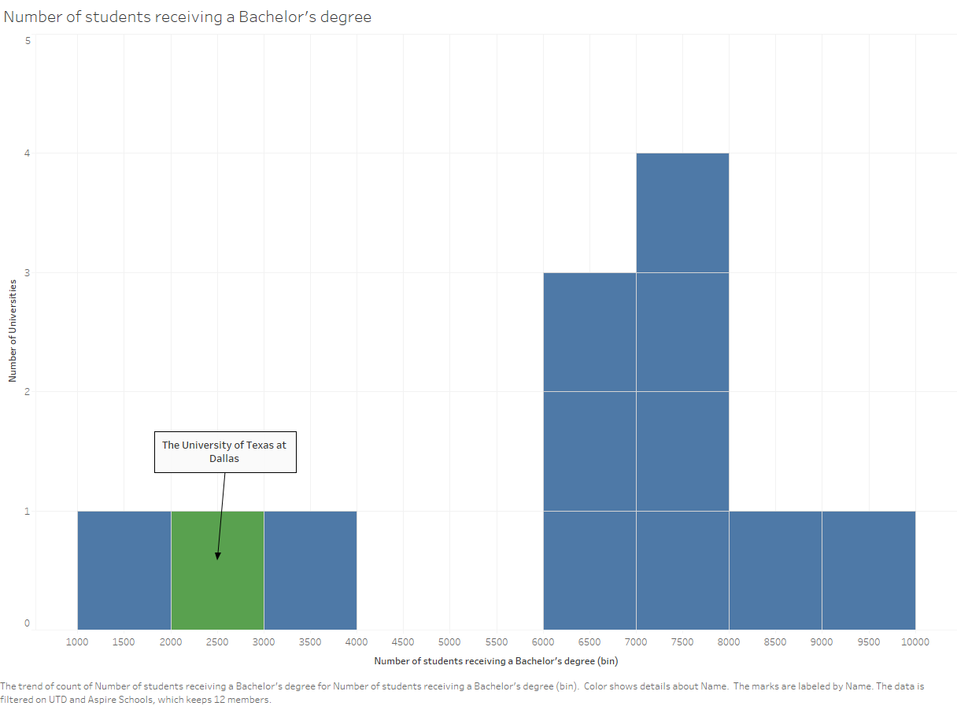
Slide 1: Histogram – Tableau
Variable: Number of Students Receiving a Bachelor's Degree
This histogram elaborates on the variable “number of students receiving a bachelor's degree”
The variable is filtered for the Aspire profile or name pertaining to UT Dallas
The bins are made of number of students who receive a bachelor’s degree
The bar length shows number of universities which fit into the respective bins

Slide 2
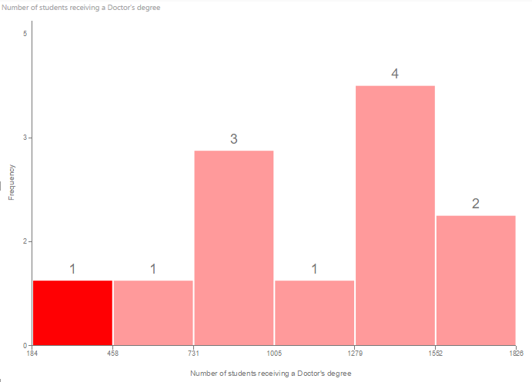
Slide 2: Histogram – PowerBI
Variable: Number of students receiving a Doctor's Degree
This Histogram elaborates on the variable “number of students receiving a doctorate degree”
The variable is filtered for Aspire profile or name pertaining to UT Dallas
The bins are made of number of students who receive a doctorate degree
The bar length shows number of universities which fit into the respective bins
UT Dallas is included in the very first bin (which is highlighted) depicting scope for improvement

Slide 3
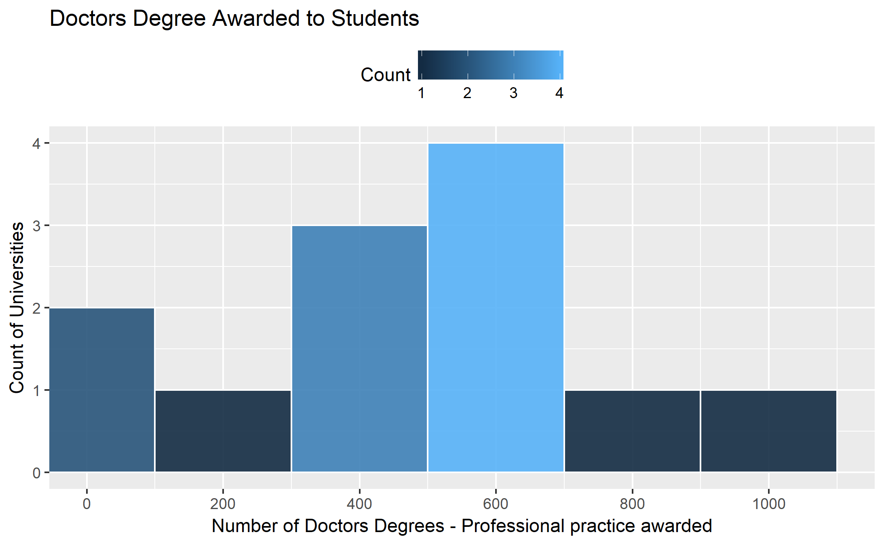
Slide 3: Histogram – ggplot2
Variable: Doctor's Degree Awarded to Students
This histogram elaborates on the variable “number of doctorate degrees-professional practice awarded”
The variable is filtered for Aspire profile or name pertaining to UT Dallas
Each bin is the number of students who receive doctorate degrees-professional practice awards
The bar length shows number of universities which fit into the respective bins
UT Dallas is included in the very first bin depicting scope for improvement

Slide 4
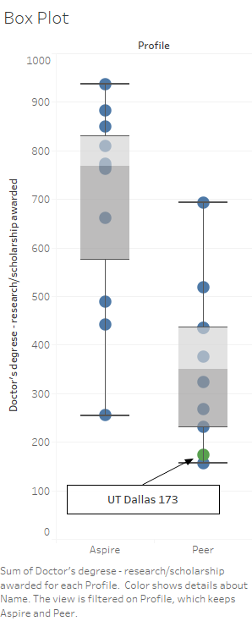
Slide 4: Boxplot – Tableau
Variable: Doctor's Degree - Research/Scholarship Awarded
This box plot shows the number of doctorate degrees - Research/scholarships awarded against each profile (Aspire and peer). It is evident that UT Dallas is lagging behind when compared to its peers and has a long way to go to reach the Aspire category

Slide 5
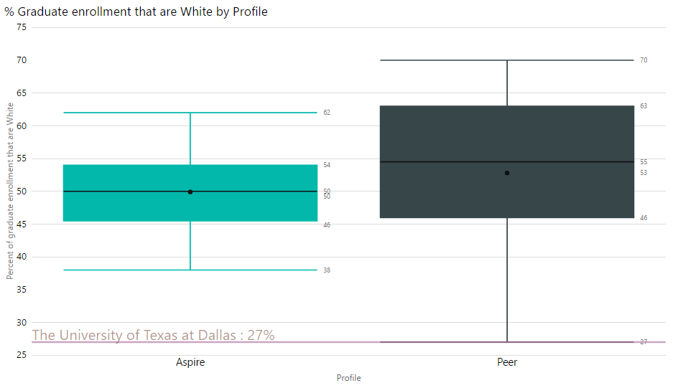
Slide 5: Boxplot – PowerBI
Variable: % of Graduate Enrollment that are White
This box plots show the % grad enrolment that are white for each profile. It is clear that the % of white people in UT Dallas is way too low compared to the other peers. The Aspire universities have a very good balance of all races as can be seen from the mean and median which are exactly 50.

Slide 6
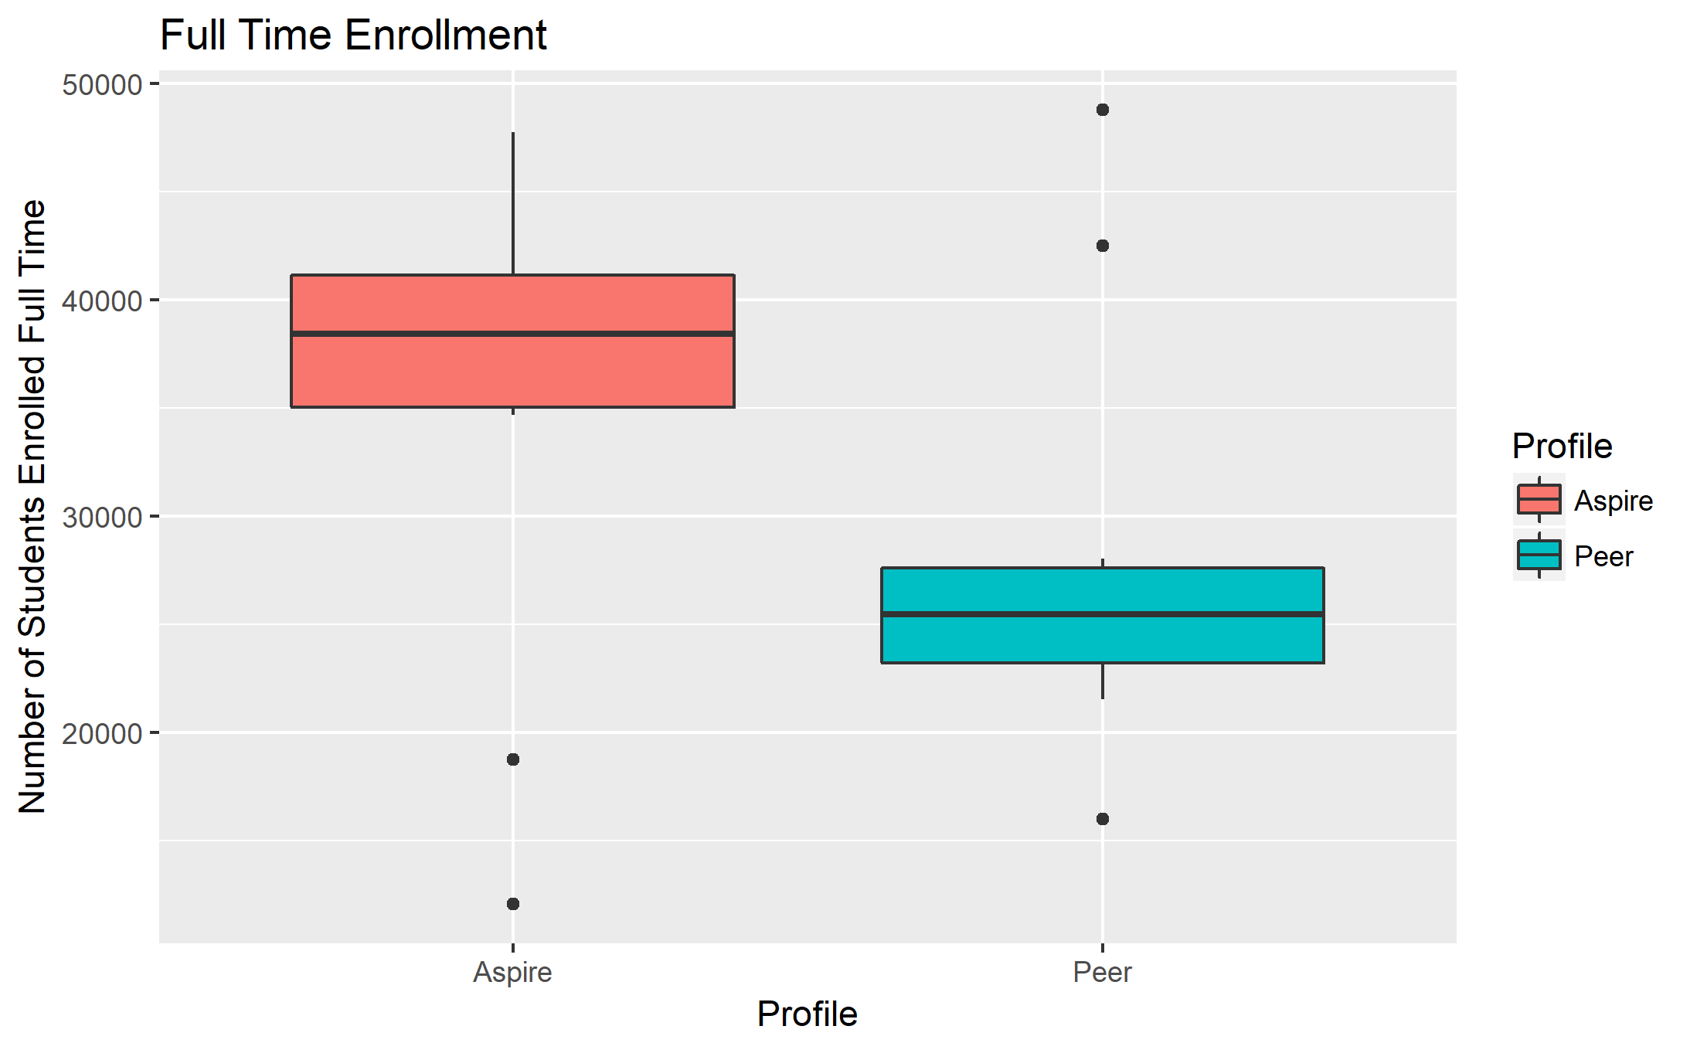
Slide 6: Boxplot – ggplot2
Variable: Number of Students Enrolled Full Time
This box plot shows the full time enrolment for each profile of universities. UT Dallas has around 16,000 full time enrolment which is much lower than its peers itself and has too much ground to cover to reach an Aspire status which has an average of almost 40,000.

Slide 7
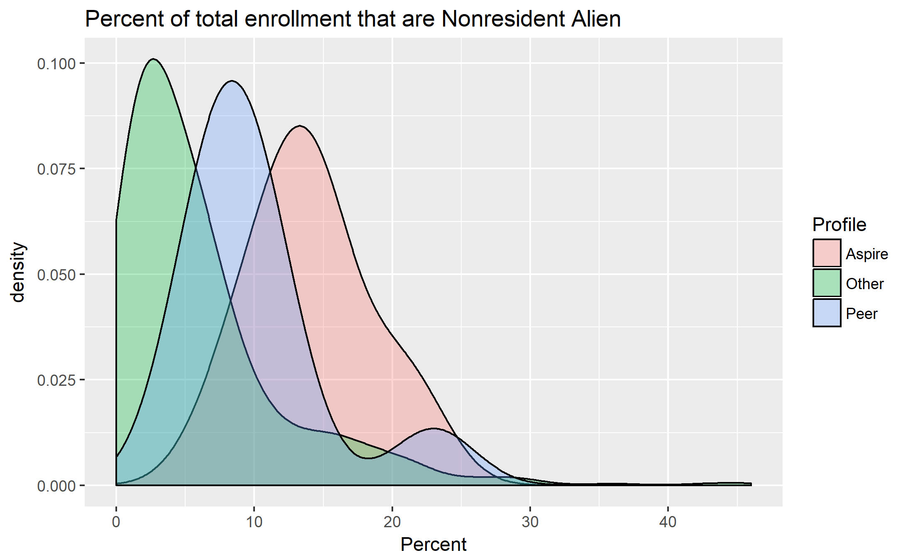
Slide 7: Density Plot – ggplot2
Variable: % of Total Enrollment that are Nonresident Alien
This is a grouped density plot of the percent of total enrollment that are nonresidential aliens in each university grouped by profile
The Aspire universities show a lower percent of non-residential alien students while colleges in the peer profile show a larger distribution
UT Dallas lies in the second highpoint of the Peer curve showing it is among those with the highest percentage of nonresident alien students

Slide 8
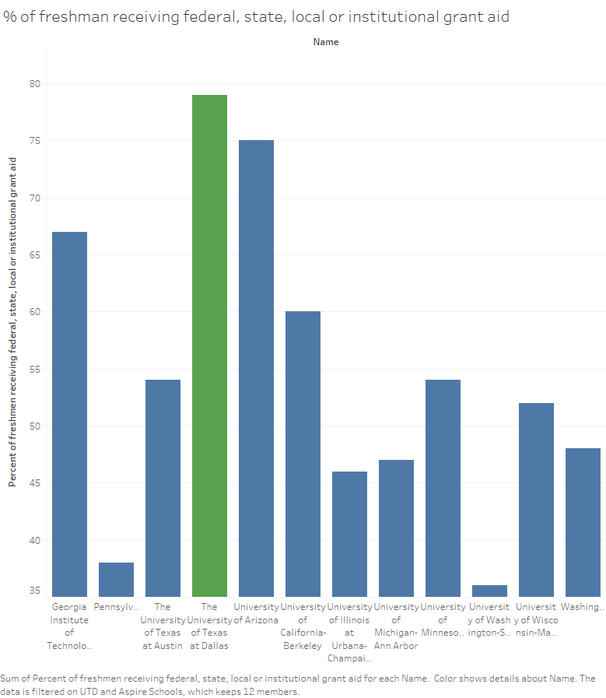
Slide 8: Bar Chart – Tableau
Variable: % of Freshmen Receiving Federal, State, Local, or Institutional Grand Aid
This bar chart represents the percent of freshmen receiving federal, state, local, or institutional grants. From the chart we can see that UT Dallas is nearly at 80% while most of the Aspire colleges are at 60% and lower.

Slide 9
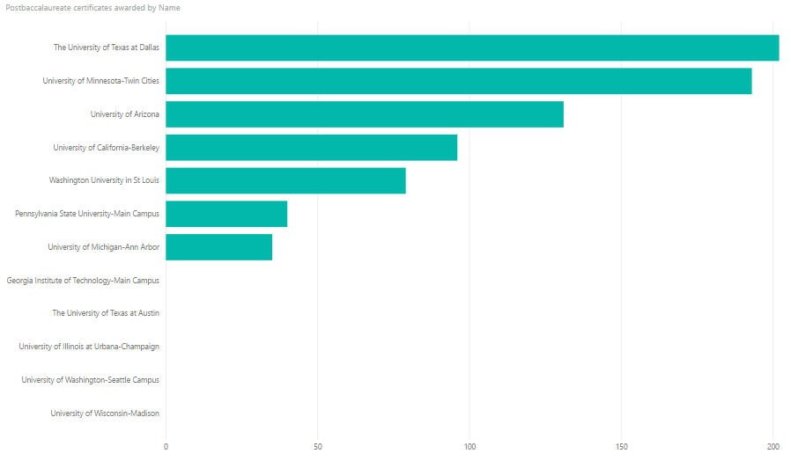
Slide 9: Bar Chart – PowerBI
Variable: Postbaccaluareate Certificate awarded
This graph represents the number of postbaccaluareate certificates awarded by school with UT Dallas having the most. Majority of the Aspire colleges award less than half that of UT Dallas if any at all.

Slide 10
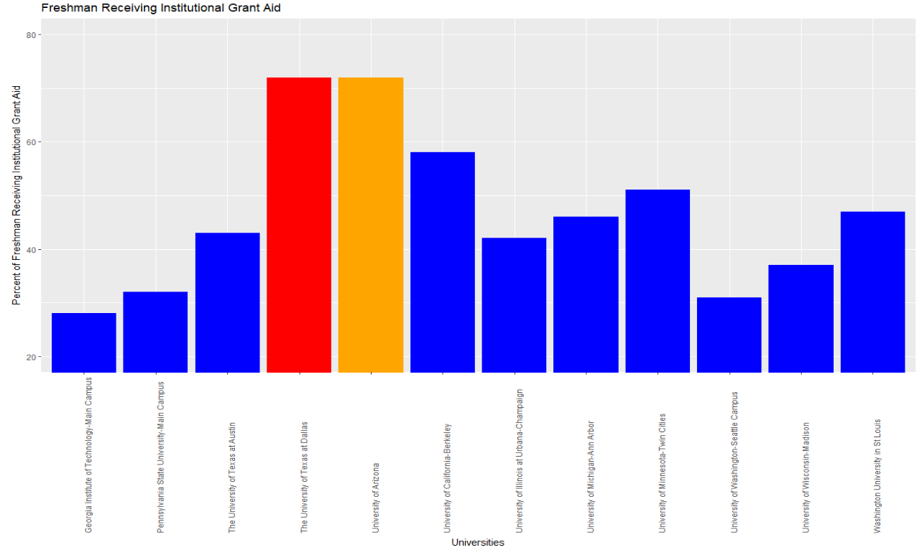
Slide 10: Bar Chart – ggplot2
Variable: % of Freshmen Receiving Institutional Grant Aid
From this graph, we can see that there is a high percentage of freshmen receiving financial aid through UT Dallas. This exceeds the percentage that freshmen in the Aspire colleges receive.

